Slide 1
Lending Club Case Study
Member:
Adityanarayanan Madhusudanan
Jalpa Patel

Slide 2
What is Lending Club?
Lending Club is a marketplace for personal loans that matches borrowers who are seeking a loan with investors looking to lend money and make a return.
Borrower
Investor
Lending club

Slide 3
Problem statement
If the applicant is likely to repay the loan, then not approving the loan results in a loss of business to the company
If the applicant is not likely to repay the loan, i.e. he/she is likely to default, then approving the loan may lead to a financial loss for the company
Identification of risky loan applicants using EDA and thus cutting down the amount of credit loss is the aim of this case study.

Slide 4
Methodology
Data understanding
Identify variables in dataset which strongly indicate the default
Data cleaning
Fixing invalid values in rows and columns
Data Analysis
Univariate Analysis
Identify data type
Understand the definition of each label
Missing values
Standardising values
Segmented Univariate
Bivariate Analysis

Slide 5
Dataset Description
The given dataset is a profile of all the customers who have requested for loans from lending club in the period 2007 - 2011.
This includes the loan amount details, and some customer behavior details whcih were collected with the purpose of getting a holistic view of their risk profile

Slide 6
Solution Approach
Since the dataset and the outcome are very specific and restricted to EDA, we have decided to go with only univariate and bivariate analysis, for the loan_status variable.
The key inference that we want to deduce out of this analysis are the indicators, which lead to the loan being defaulted, so that given values for those key indicators, it can be predicted whether the loan is going to be defaulted or not

Slide 7
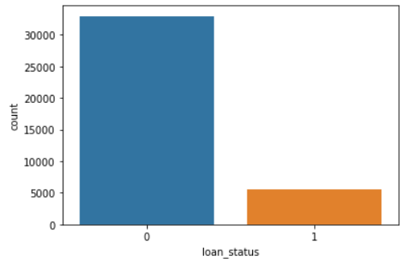
Analysis
As stated in the data transformation section above, we have transformed the loan status variable into 0 for Fully Paid and 1 for Charged Off.
Therefore, from the above plot it is clear that more than 30000 entries correspond to fully paid off loans and about 5000 entries are Charged Off.

Slide 8
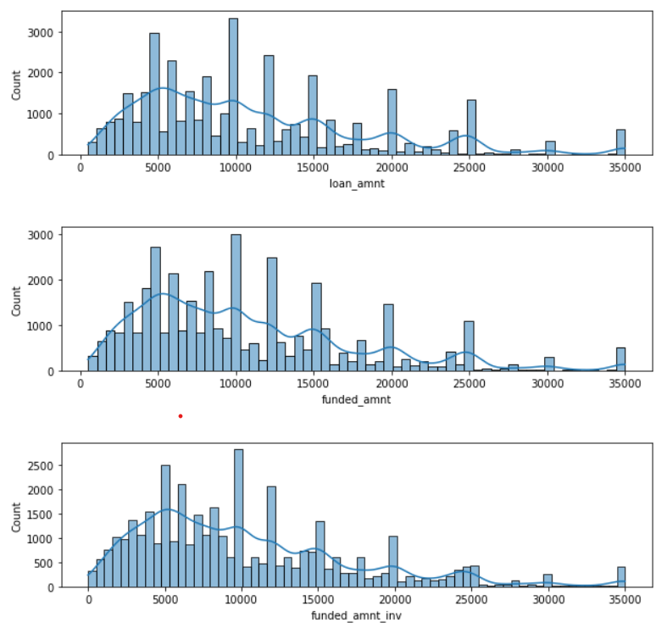
Most of the loan listings that are requested and funded lie in the range of 5000 to 15000 dollars.

Slide 9
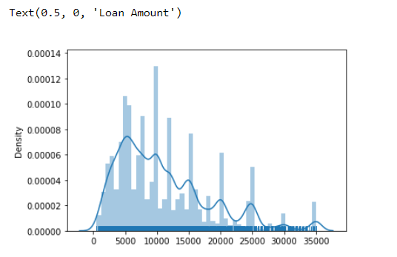
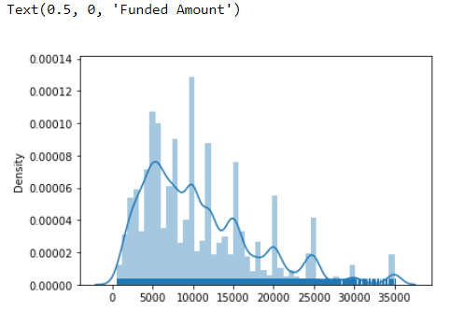
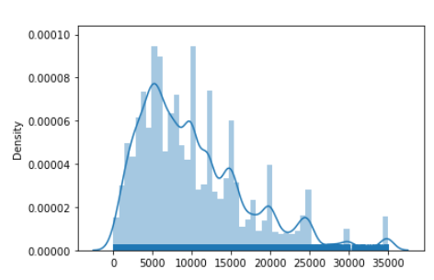
funded _amnt_inv
Distribution of loan amnt, Funded amnt and funded amnt by investor is same.

Slide 10
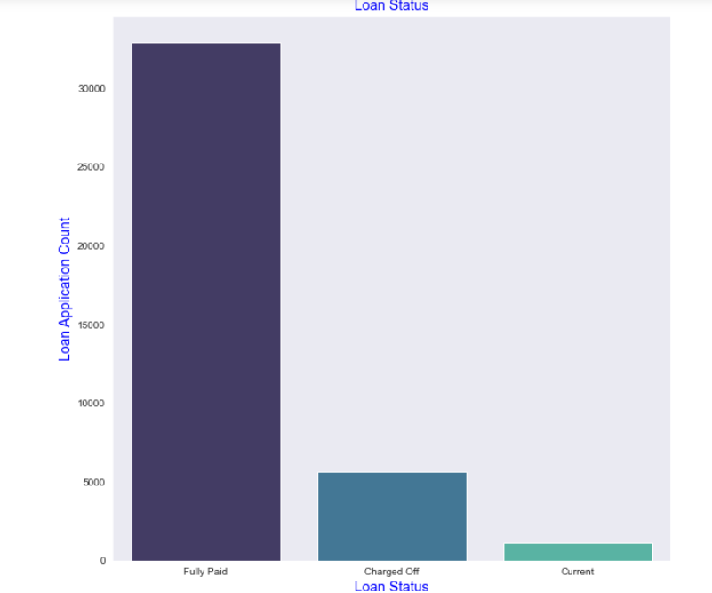
 | Loan Application Count
Fully Paid | 32609
Charged Off | 5584
Current | 1126

Slide 11
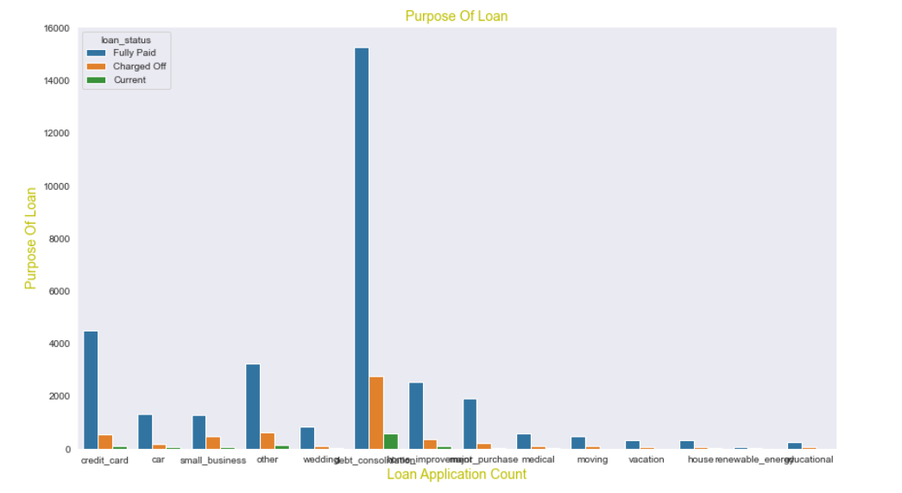
Debt consolidation & credit card bill has max value means maximum loan has been taken for these purpose

Slide 12
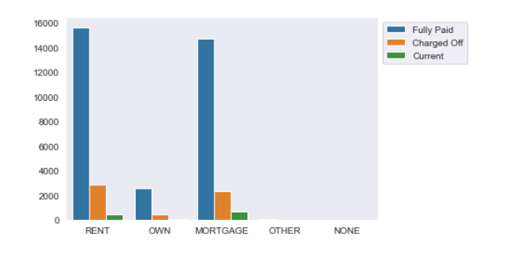
We can concluded that most of the applicants living in rented home or mortgazed their home.No of applicants are high from this category so that charged off is high

Slide 13
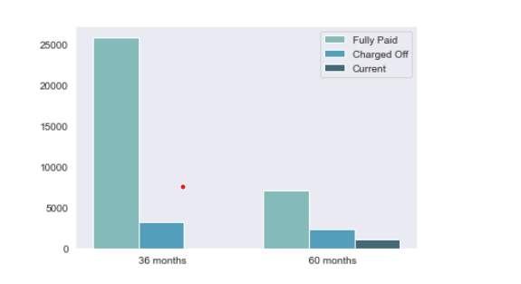
Applicants who had taken loan for 60 months are more compared to the number of applicants getting charged off as compared to applicants who had taken loan for 36 months.

Slide 14
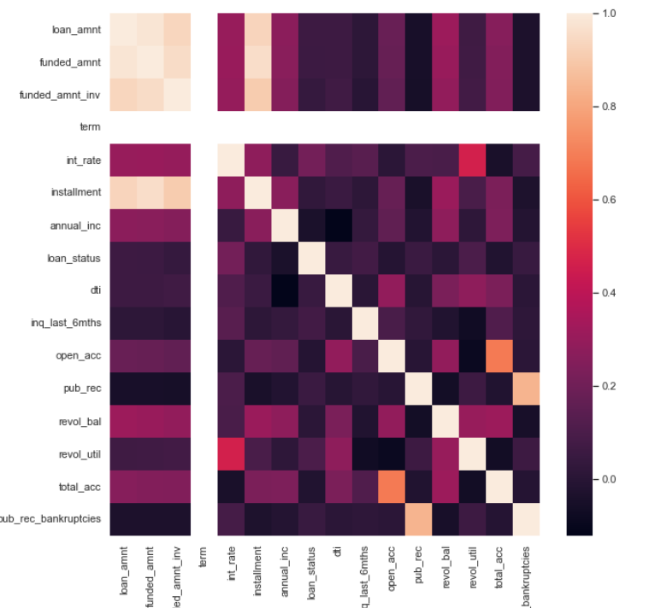

Slide 15
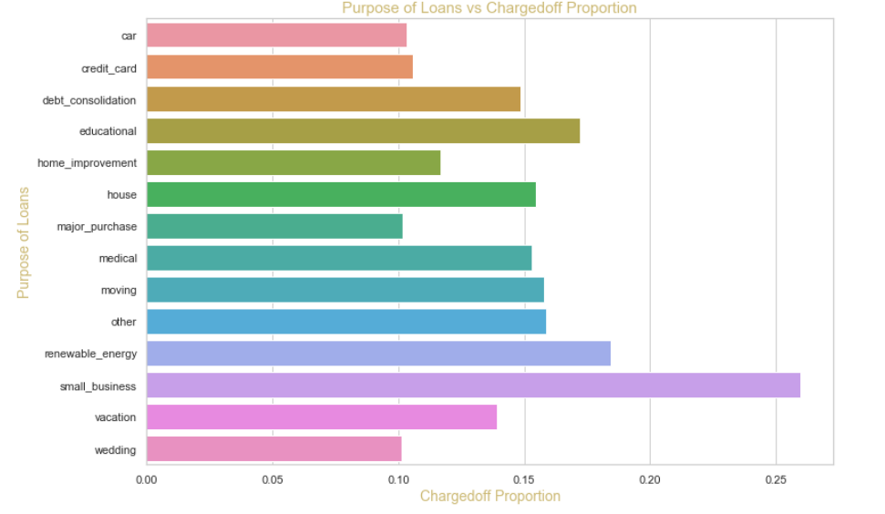
small Business applicants have high chances of getting charged off.

Slide 16
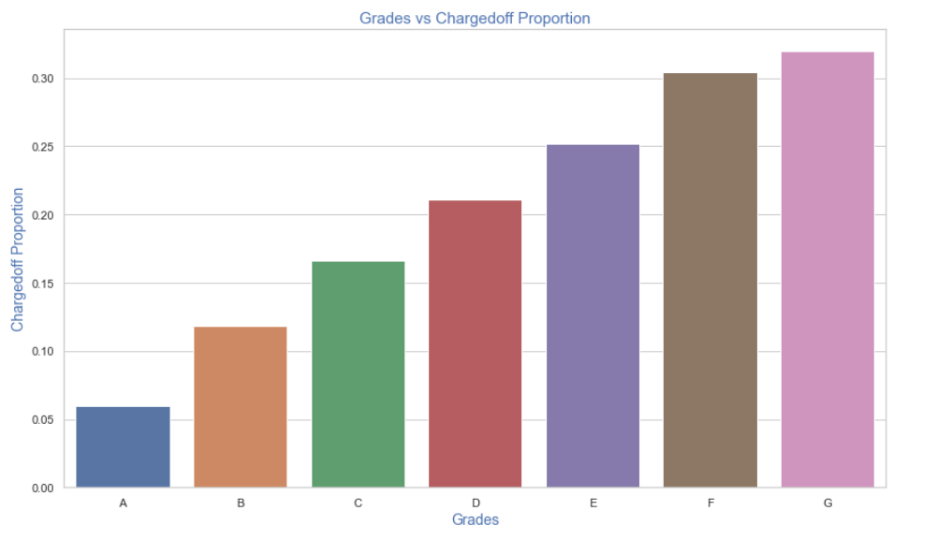
from "A" towards "G“, Chances of charged off is increasing with grade moving

Slide 17
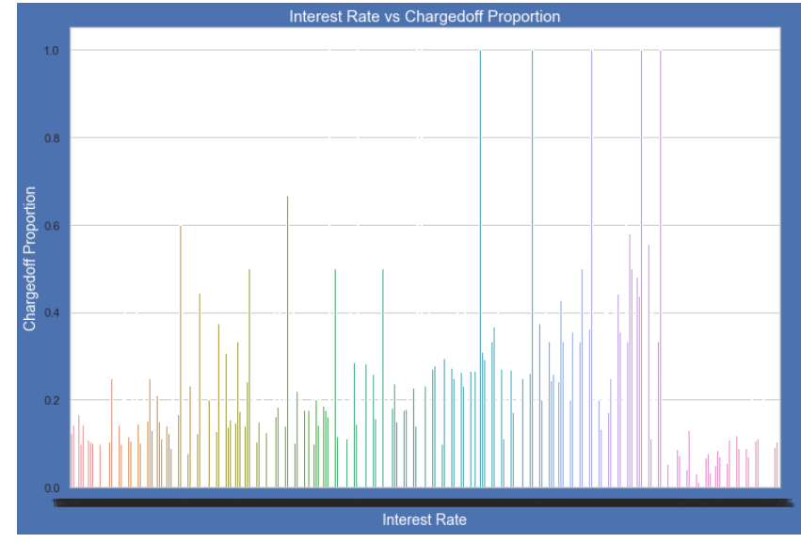
Charged off proportion is increasing with higher intrest rates

Slide 18
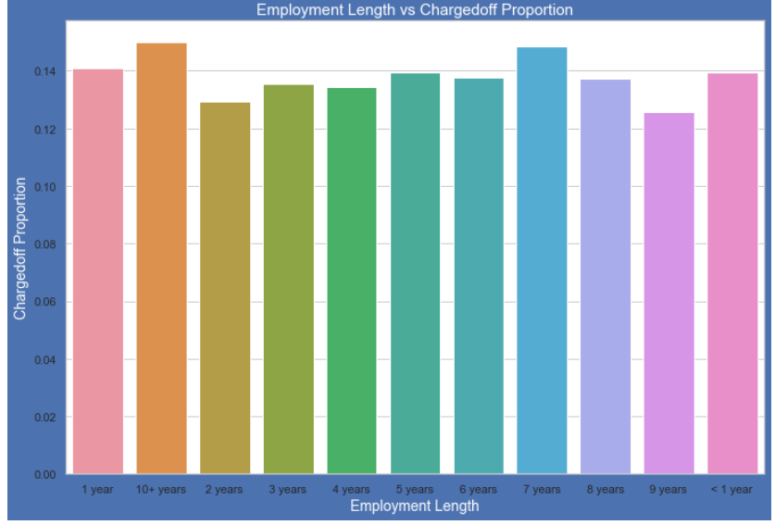
Applicants who are not working or have less than 1 year of work experience have high chances of getting charged off.

Slide 19
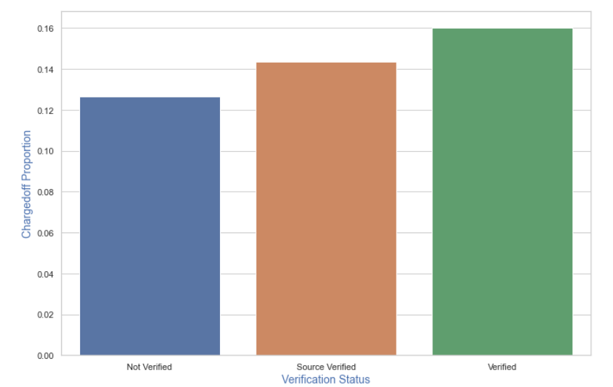
No huge difference between three category

Slide 20
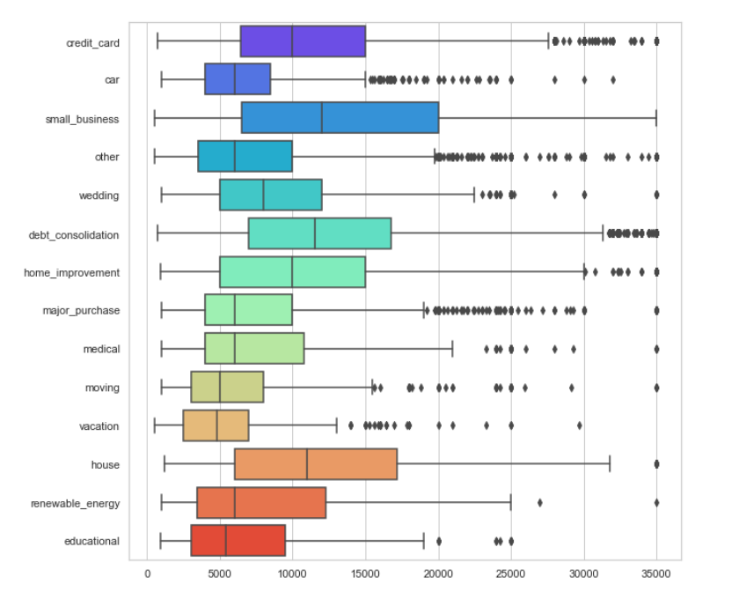
75th percentile of loan amount is highest for loan taken for small business purpose.

Slide 21
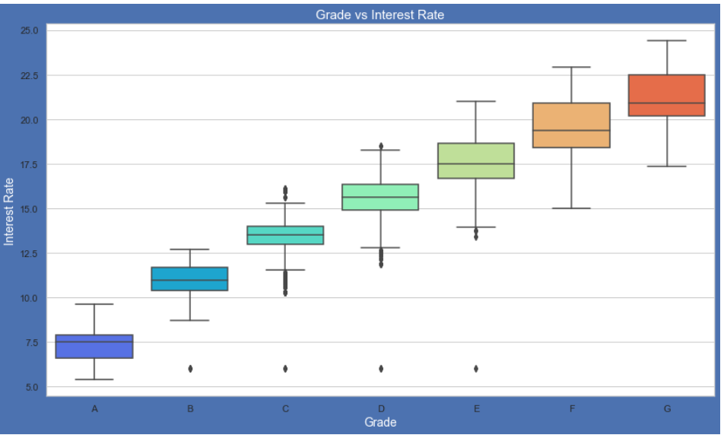
higher the borrower's credit grade, the lower the interest rate

Slide 22
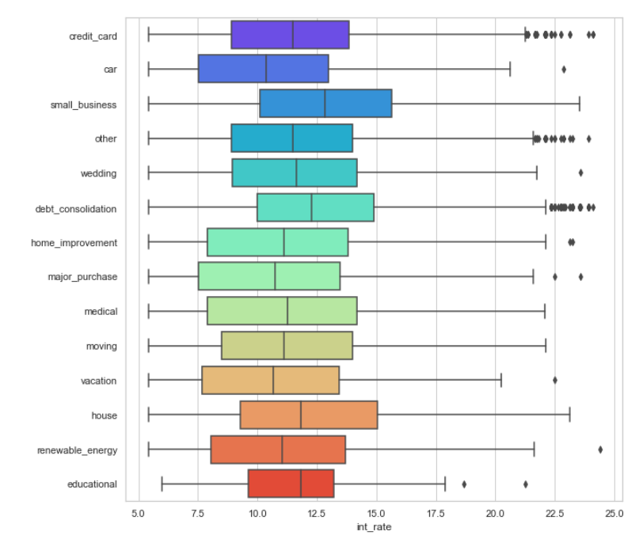
average interest rate is highest for small business purpose

Slide 23
Conclusion
Distribution of amounts for all three looks very much similar.
Interest rate is increasing with loan amount increase this results in high charged off.
From lending club dataset, we can conclude that Applicants who had been 'charged off' have lower annual incomes than the ones who'paid fully' for each and every grade.
There is no significant change in DTI w.r.t interest rate.
Loans taken for small business purposes had to repay the loan with more interest rate as compared to other.
Most of the loan applications for longer term(60 Month) had higher intrest rates for repayment.

